Slide 1
Distributed Control and Automation Framework (DCAF)
RT Key Concepts Review
Instructor Name
Notes:
People that contributed with this content:
Benjamin Celis
Andres Gomez

Slide 2
Concepts to Review
Jitter
Determinism
Real Time OS
Priorities
Parallelism
Timing
Notes:
Questions are proposed in the next slides. The idea is that students are the ones responding questions based on their background. Add questions as needed for them to get to the answer and generate discussion.
Most of the answers in this presentation have been taken from the EMC class or LabVIEW help.

Slide 3
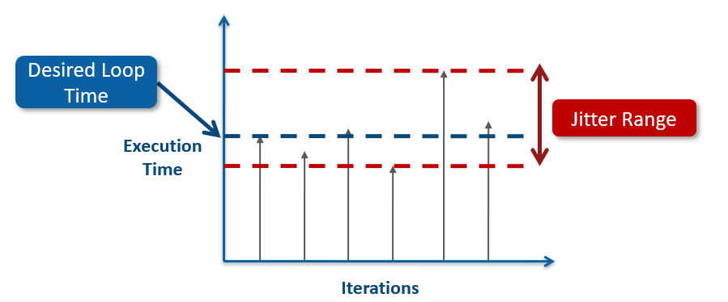
What is Jitter?
Notes:
Execution time variability of a given operation or application

Slide 4
What is Determinism?
A condition that is met if an operation or application has bounded jitter

Slide 5
What is a Real Time OS? How is it different from a general purpose OS?
Designed to meet the needs of critical, stand-alone applications
High reliability
Run application continuously for days, weeks, months
Deterministic timing
Consistently responds to events and performs tasks within a low, bounded amount of time
Ensure high-priority tasks execute first

Slide 6
What is a High Priority Process?
Critical tasks that must complete on time, every time. Therefore, they need dedicated processor resources.
Higher priority processes preempt lower priority processes
Processes that must be deterministic are time-critical processes—set all other processes to a lower priority.

Slide 7
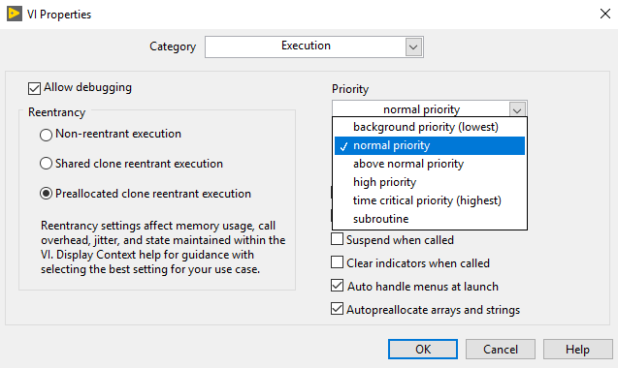
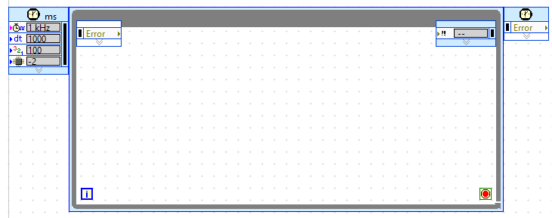
What options do we have in LV Real-Time to assign more priority for one of our tasks?
Notes:
Once students answer, ask the next follow up questions:
Is it a good practice to mix these 2 methods?
How many timed loops should our RT application contain?

Slide 8
What type of elements/practices can cause jitter in my high priority processes?
Global variables.
Non-reentrant subVIs.
Memory Requests (LV Memory Manager).
Networking Code.
File IO.
Semaphores.
Single threated DLLs.

Slide 9
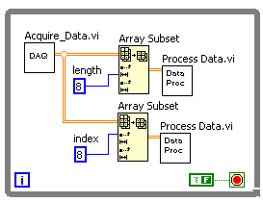
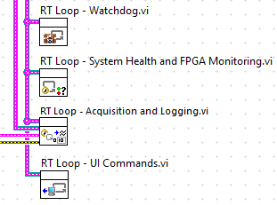
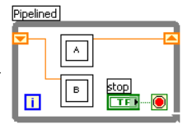
How can we parallelize tasks in LVRT?
Parallel Loops
Parallel Data Processing
Pipelining Operations
Notes:
Discuss the challenges of keeping determinism while communicating several processes that run in parallel.

Slide 10
Can we parallelize code inside a Timed Loop?
No. Each timed loop is mapped to a single thread. This means all the code inside a timed structure executes sequentially.

Slide 11
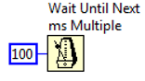
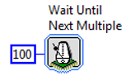
How Do I Time my Processes?
Standard wait functions.
Embedded timing functionality of timed loops.
Can be synchronized to scan engine.
External hardware sources.
Blocking calls (like queue reads that wait for element).
Notes:
Timing Timed Loops:
Automatically imposes sleep as needed to achieve the specified loop rate
Configure the highest priority Timed Loop with a period large enough to perform the deterministic task and have idle time to allow lower priority loops to execute.
It is worth mentioning that for the majority of the cases we will not need to time our DCAF modules since the engine will take care of this based on our configuration.

